Slide 1
Soft Computing Project: Cervical Cancer Risk Classification Submitted to Dr. Aditya Khamparia

Slide 2
Cervical Cancer
Cervical cancer is the leading gynecological malignancy worldwide. This presents diverse classification techniques and shows the advantage of feature selection approaches to the best predicting of cervical cancer disease. There are thirty-two attributes with eight hundred and fifty-eight samples. Besides, this data suffers of missing values and imbalance data. Therefore, over-sampling, under-sampling and imbedded over and under sampling have been used. Furthermore, dimensionality reduction techniques are required for improving the accuracy of the classifier. Therefore, feature selection methods have been studied as they divided into two distinct categories, filters and wrappers. The results show that age, first sexual intercourse, number of pregnancies, smokes, hormonal contraceptives and STDs:genital herpes are the main predictive features with high accuracy with 97.5%. Decision Tree classifier is shown to be advantageous in handling classification assignment with excellent performance.

Slide 3
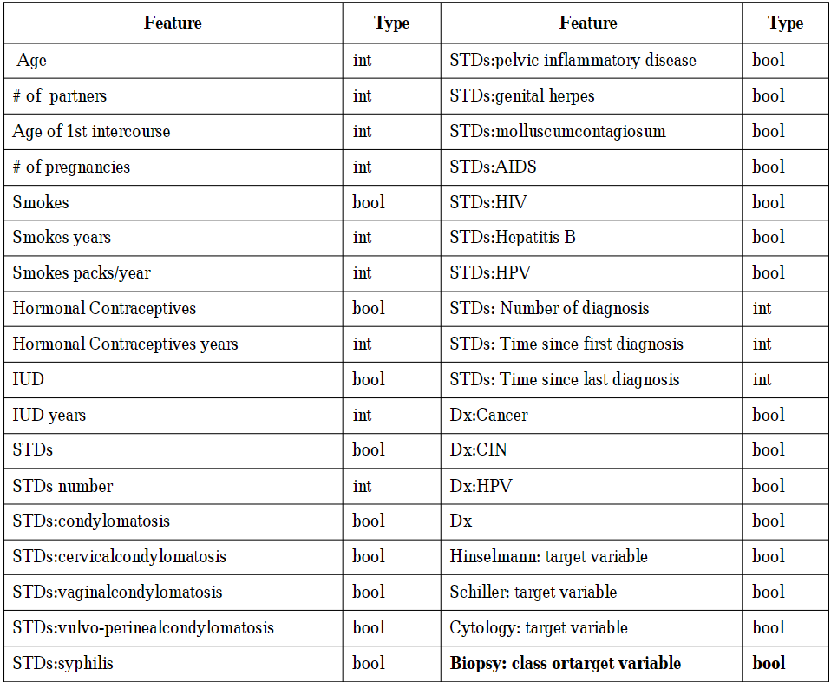
Cervical Cancer
Risk Factors

Slide 4
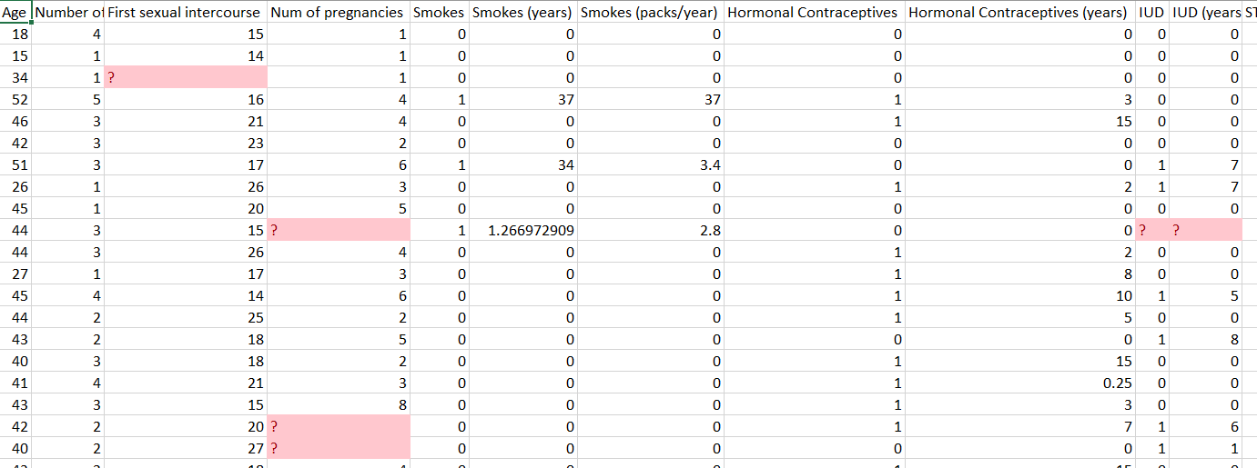
Dataset Management
-Null Value Management : By Replacing ‘?’ with NaN(Not a number).

Slide 5
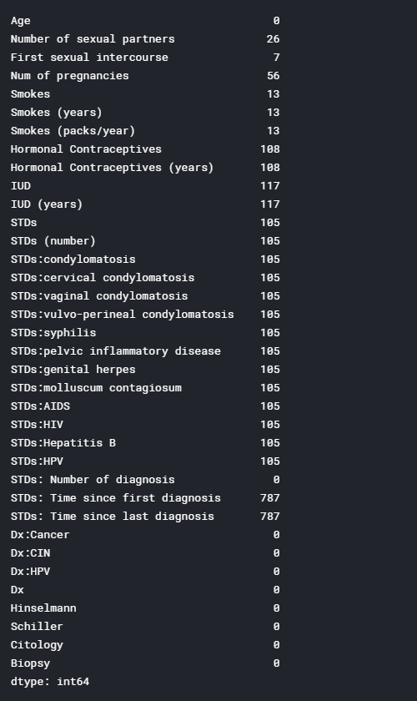
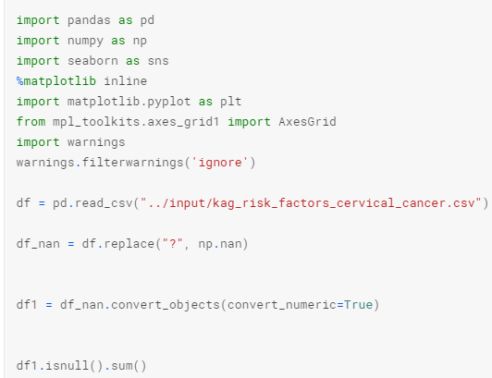
Dataset Management
-Null Value Management : By Replacing ‘?’ with NaN(Not a number). And Calculation of NaN Values per column.

Slide 6
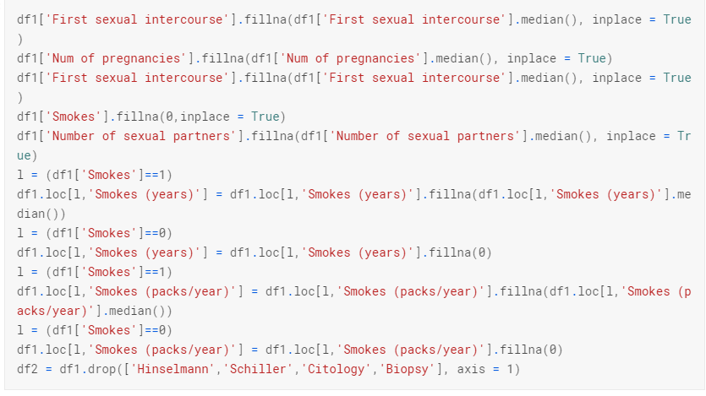
Handle NaN’s
To handle Nan we have to see correlation between variables. But according to data, size higher than 100 NaN values can be effect data. We can fill features which have lower than 100 Nan values with median values.

Slide 7
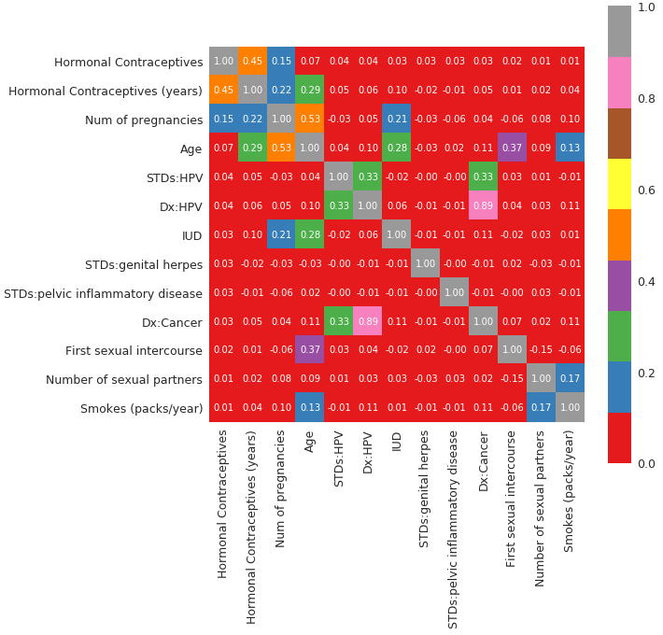
Hormonal Contraceptives (HC)
In the data diagnosis data have too much Nan values. Because of that we cannot determine effect of this data. We have to drop them. Then using Pearson correlation we can determine which feature is effect 'Hormonal Contraceptives’.(Top 15 correlation values )

Slide 8
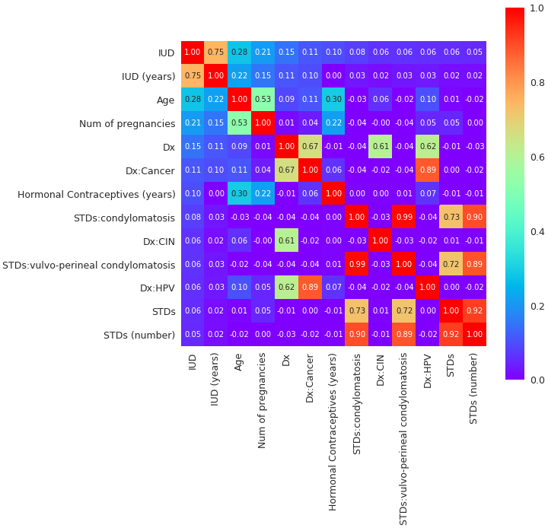
IUD
Using Pearson correlation we can determine which feature is effect 'IUD'.

Slide 9
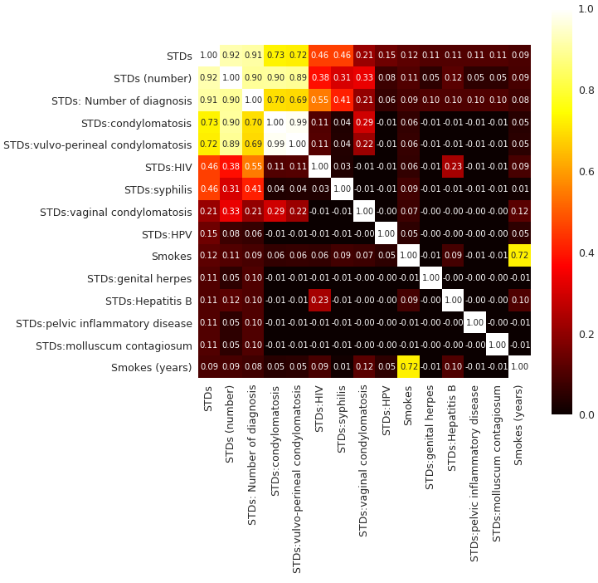
STDs

Slide 10
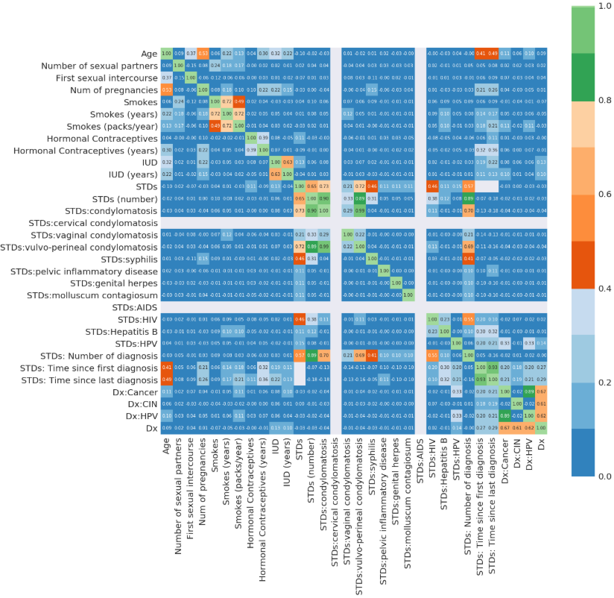
STDs Diseases

